Slide 1
ZK Constructions #2
ZK IAP 2023
Brian Gu

Slide 2
Today
Dark Forest and ZK for Incomplete Information Games
Quick intro to Ethereum
ZK Data Marketplace and Nightmarket Construction
ZKML
ZK Recursion: ETHDos

Slide 3
Dark Forest slides

Slide 4
Dark Forest Construction (2019)

Slide 5
Game Construction
Everyone lives on large 2-D grid

Slide 6
Game Construction
Everyone lives on large 2-D grid
For location (x, y), hash(x,y) is location’s public address.
The coordinates themselves are the location’s private address.

Slide 7
Game Construction
Everyone lives on large 2-D grid
For location (x, y), hash(x,y) is location’s public address.
Locations (x,y) such that
hash(x,y) < DIFFICULTY_THRESHOLD
have habitable planets. All other spaces are empty.

Slide 8
Game Construction
Everyone lives on large 2-D grid
For location (x, y), hash(x,y) is location’s public address.
Locations (x,y) such that
hash(x,y) < DIFFICULTY_THRESHOLD
have habitable planets. All other spaces are empty.
Player-controlled units live on planets the player owns.

Slide 9
Game Construction: State
Public State
Which public addresses are owned, who owns them, and their populations

Slide 10
Game Construction: State
Public State
Which public addresses are owned, who owns them, and their populations
Private State
Private addresses (x,y) of player’s planets
Information learned from computation

Slide 11
Player Action: Init
function initializePlayer(uint planetId, uint claimedDist, Proof zkProof)
Initialize a player at coordinates with ID planetId. Also checks that these coordinates are within some claimed distance from the origin.

Slide 12
Player Action: Init
function initializePlayer(uint planetId, uint claimedDist, Proof zkProof)
zkProof: I know some coordinates (x, y) such that
hash(x, y) = planetId
x^2 + y^2 < claimedDist^2

Slide 13
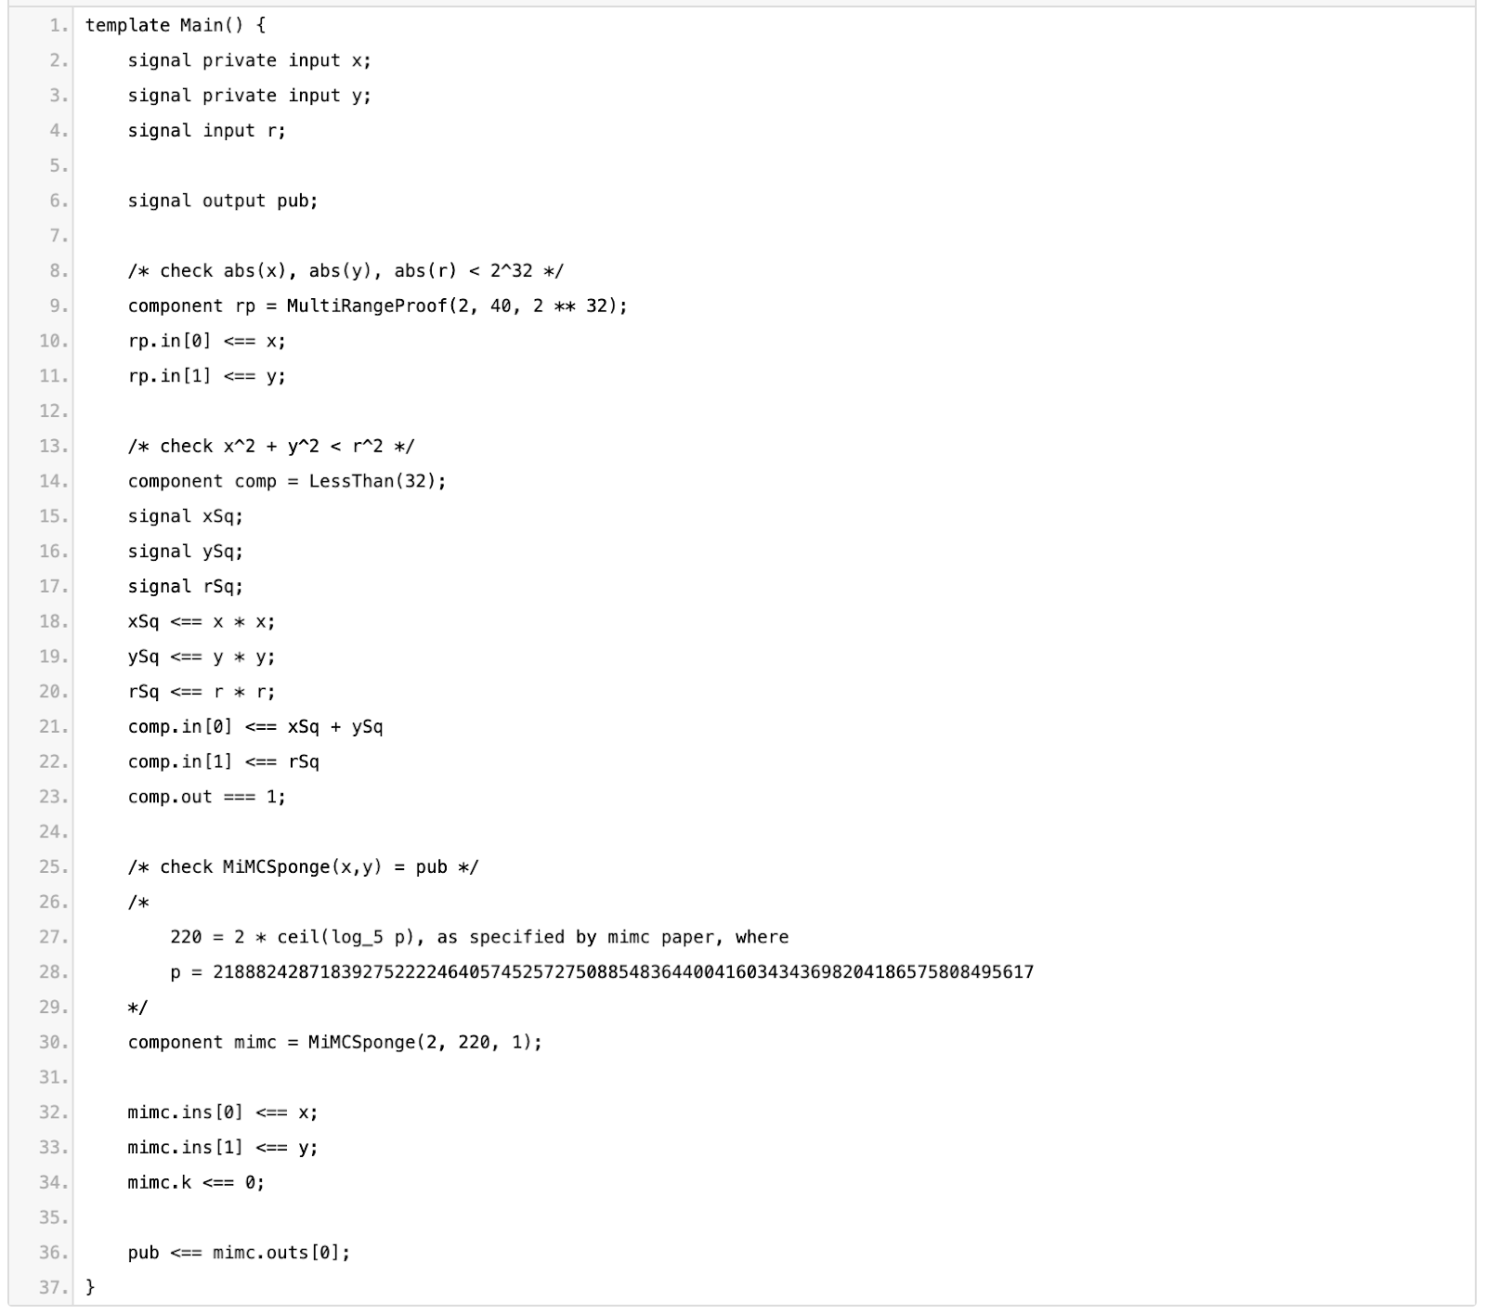
Player Action: Init

Slide 14
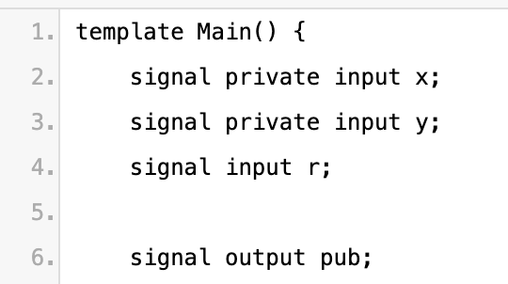
Inputs & outputs

Slide 15
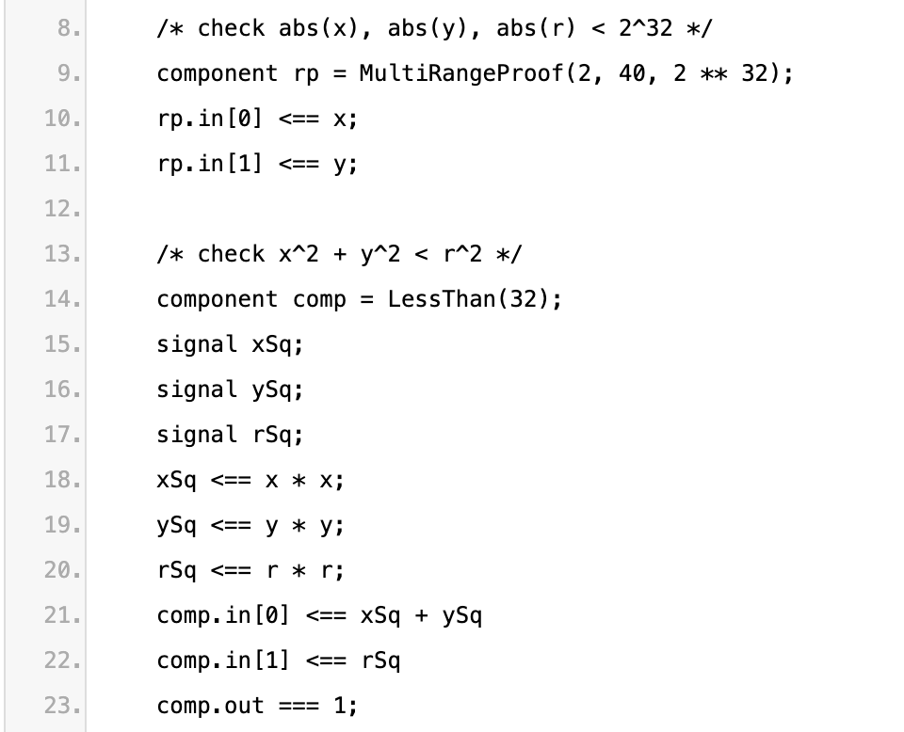
Range Proofs

Slide 16
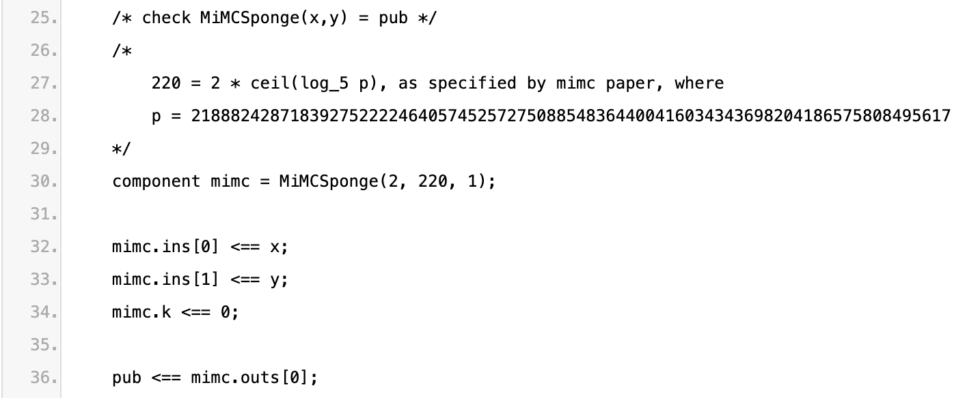
Hash Preimage

Slide 17
Player Action: Move
function move(uint fromPlanetId, uint toPlanetId, uint worldRadius, uint maxDist)
Move forces from fromPlanetId to toPlanetId.
Check that both planets are “in bounds”
Pay some cost depending on maxDist between the two planets.

Slide 18
Player Action: Move
function move(uint fromPlanetId, uint toPlanetId, uint worldRadius, uint maxDist)
zkProof: I know some coordinates (x1, y1) and (x2, y2) such that
hash(x1, y1) = fromPlanetId
hash(x2, y2) = toPlanetId
x2^2 + y2^2 < worldRadius^2
(x1-x2)^2 + (y1-y2)^2 < distMax^2

Slide 19
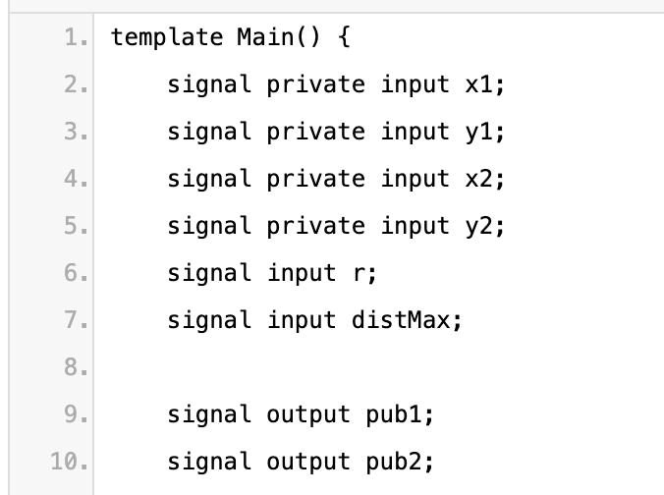
Inputs & outputs

Slide 20
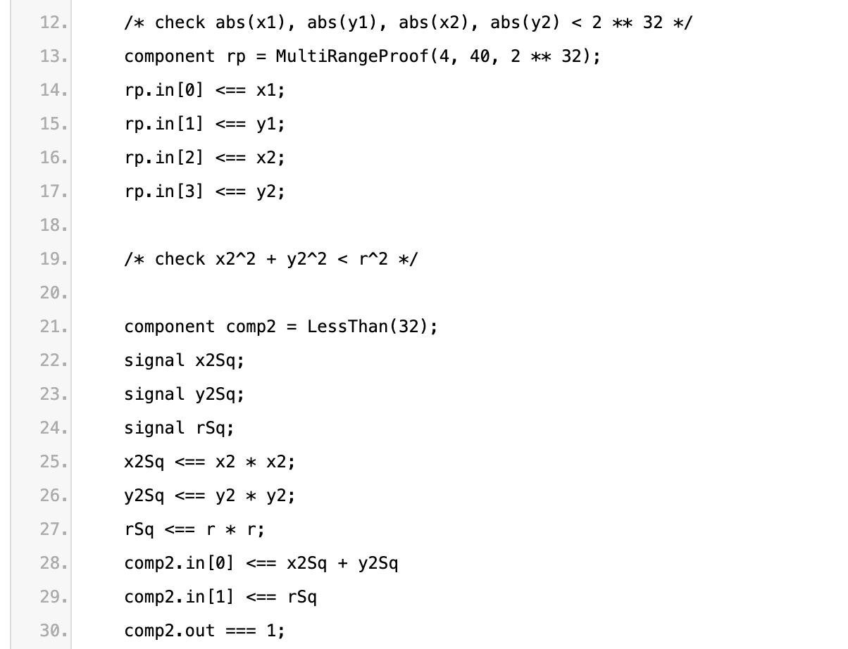
Range Proofs

Slide 21
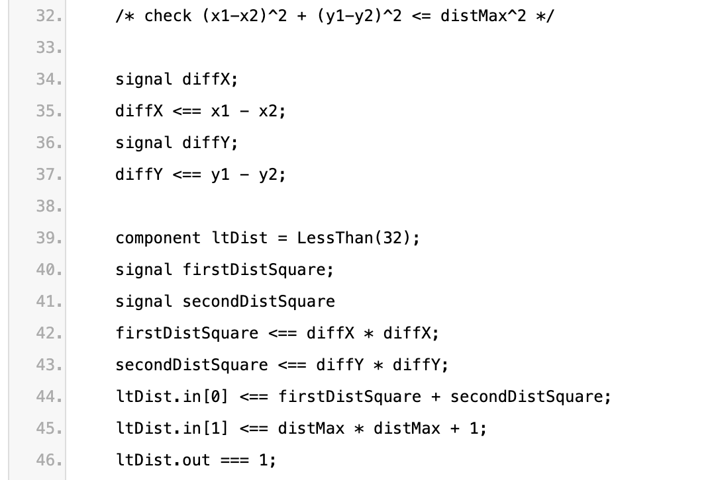
Distance Proof

Slide 22
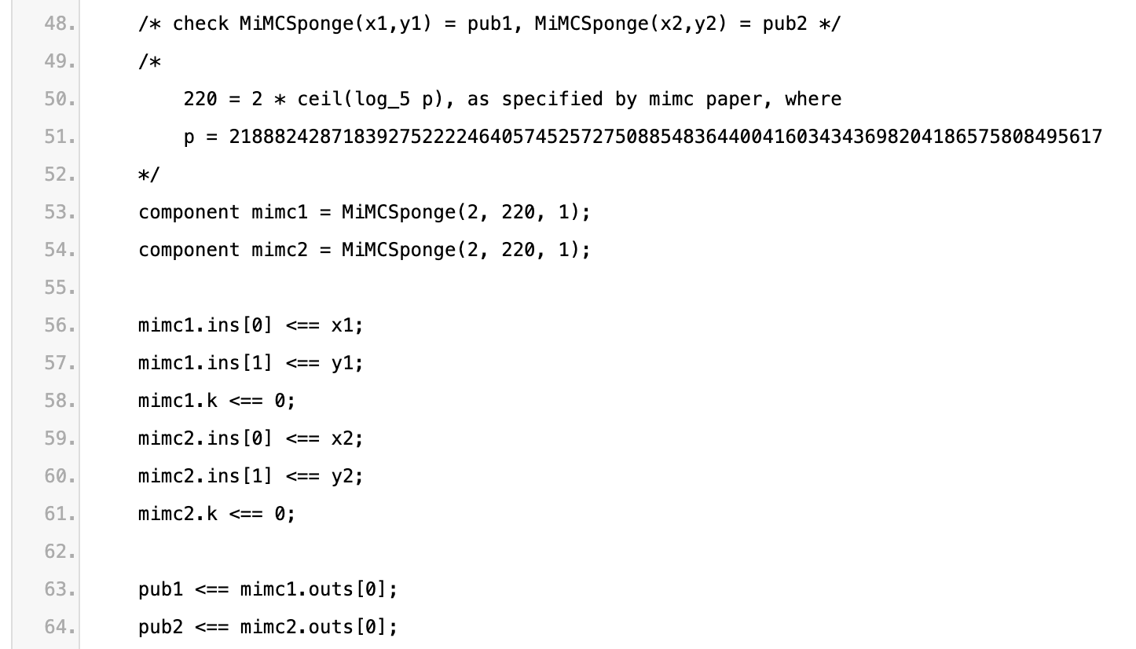
Hash Preimages

Slide 23
Demo (then switch decks)

Slide 24
ZK Data Marketplace

Slide 25
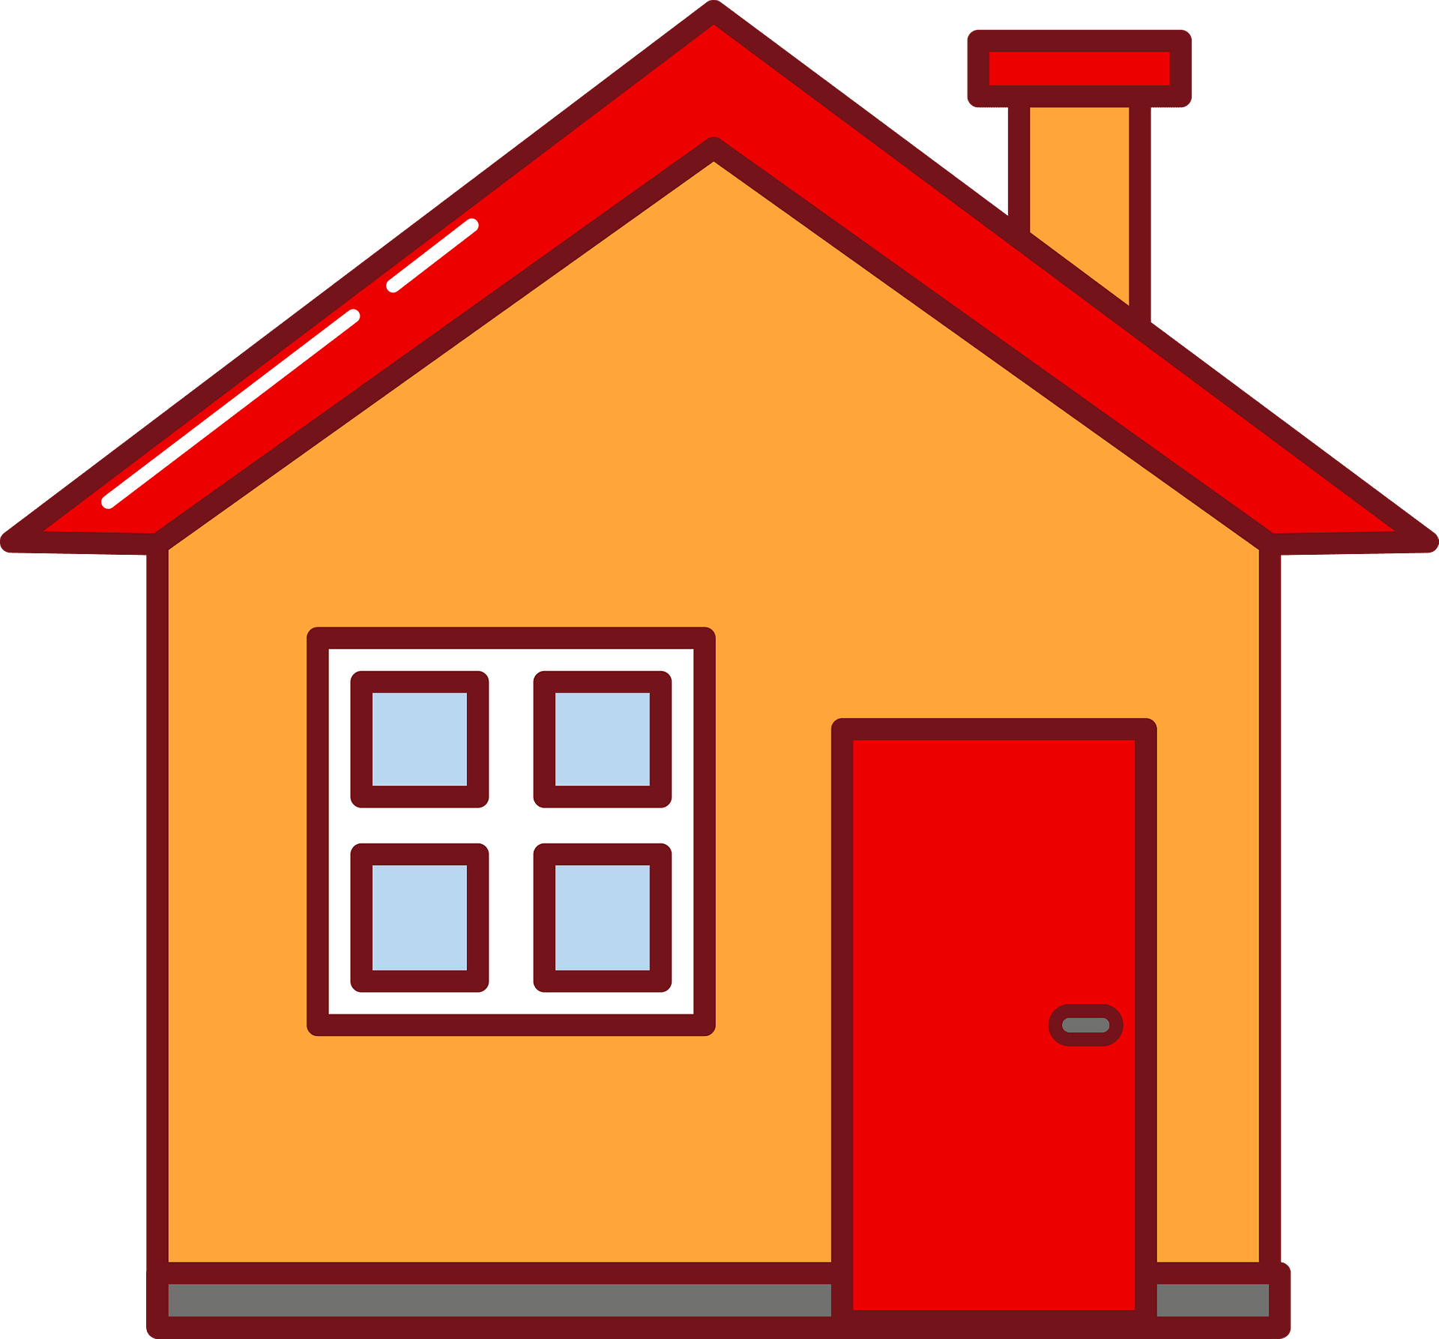

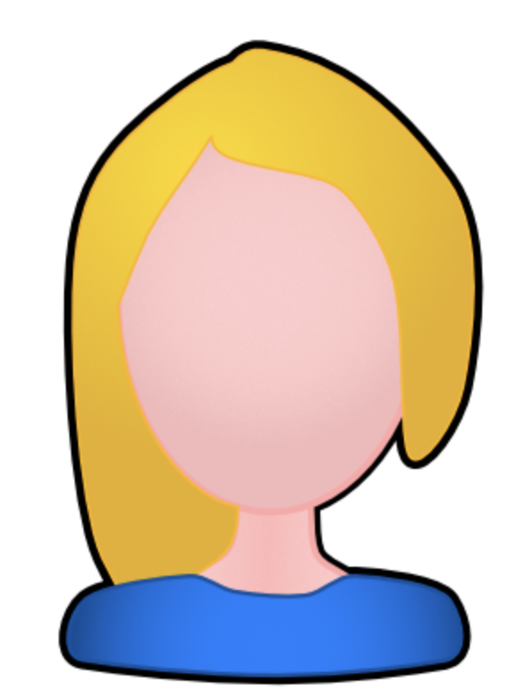
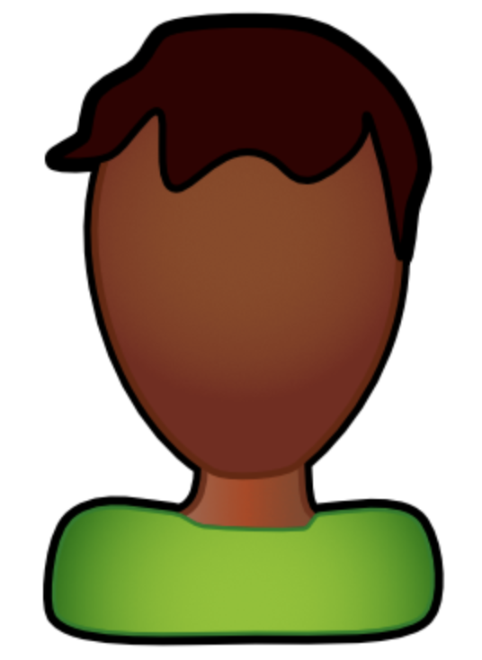
Escrow

Slide 26

Escrow

Slide 27
Escrow

Slide 28
Escrow

Slide 29
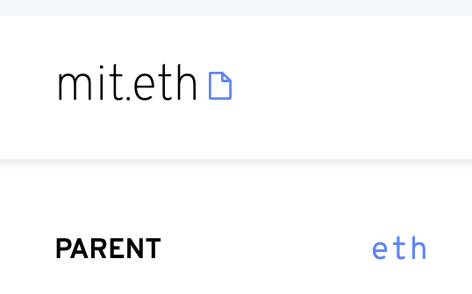
Escrow

Slide 30

Escrow

Slide 31
Escrow

Slide 32
Escrow

Slide 33
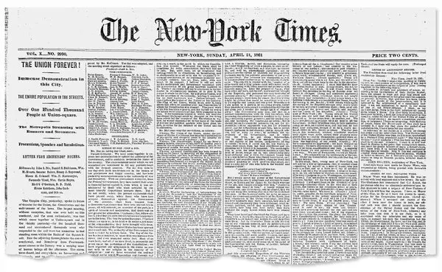
Escrow
?????

Slide 34
On-Chain Marketplace
Toy example: Bob wants to buy the preimage of 0x98b3f001 from Alice

Slide 35
On-Chain Marketplace
Escrow contract checks that both buyer and seller have fulfilled conditions:
Bob has locked up $$ in escrow
Alice has published the data the buyer wants
Problem:
The only way that the contract can check seller’s condition is if it can read the seller’s data!

Slide 36
Solution
Alice publishes data encrypted with buyer’s public key
Alice also publishes a zkSNARK proof that this ciphertext is the correct data, encrypted with Bob’s public key
Smart contract only releases funds to Alice if zkSNARK proof verifies
https://github.com/nulven/EthDataMarketplace - Nick Ulven (2021)

Slide 37
Solution
Public Input:
Buyer public key pk
Ciphertext c
Commitment h
Private Input:
Secret data s
Proves:
Hash(s) = h (or property(s) = h)
Enc(s, pk) = c

Slide 38
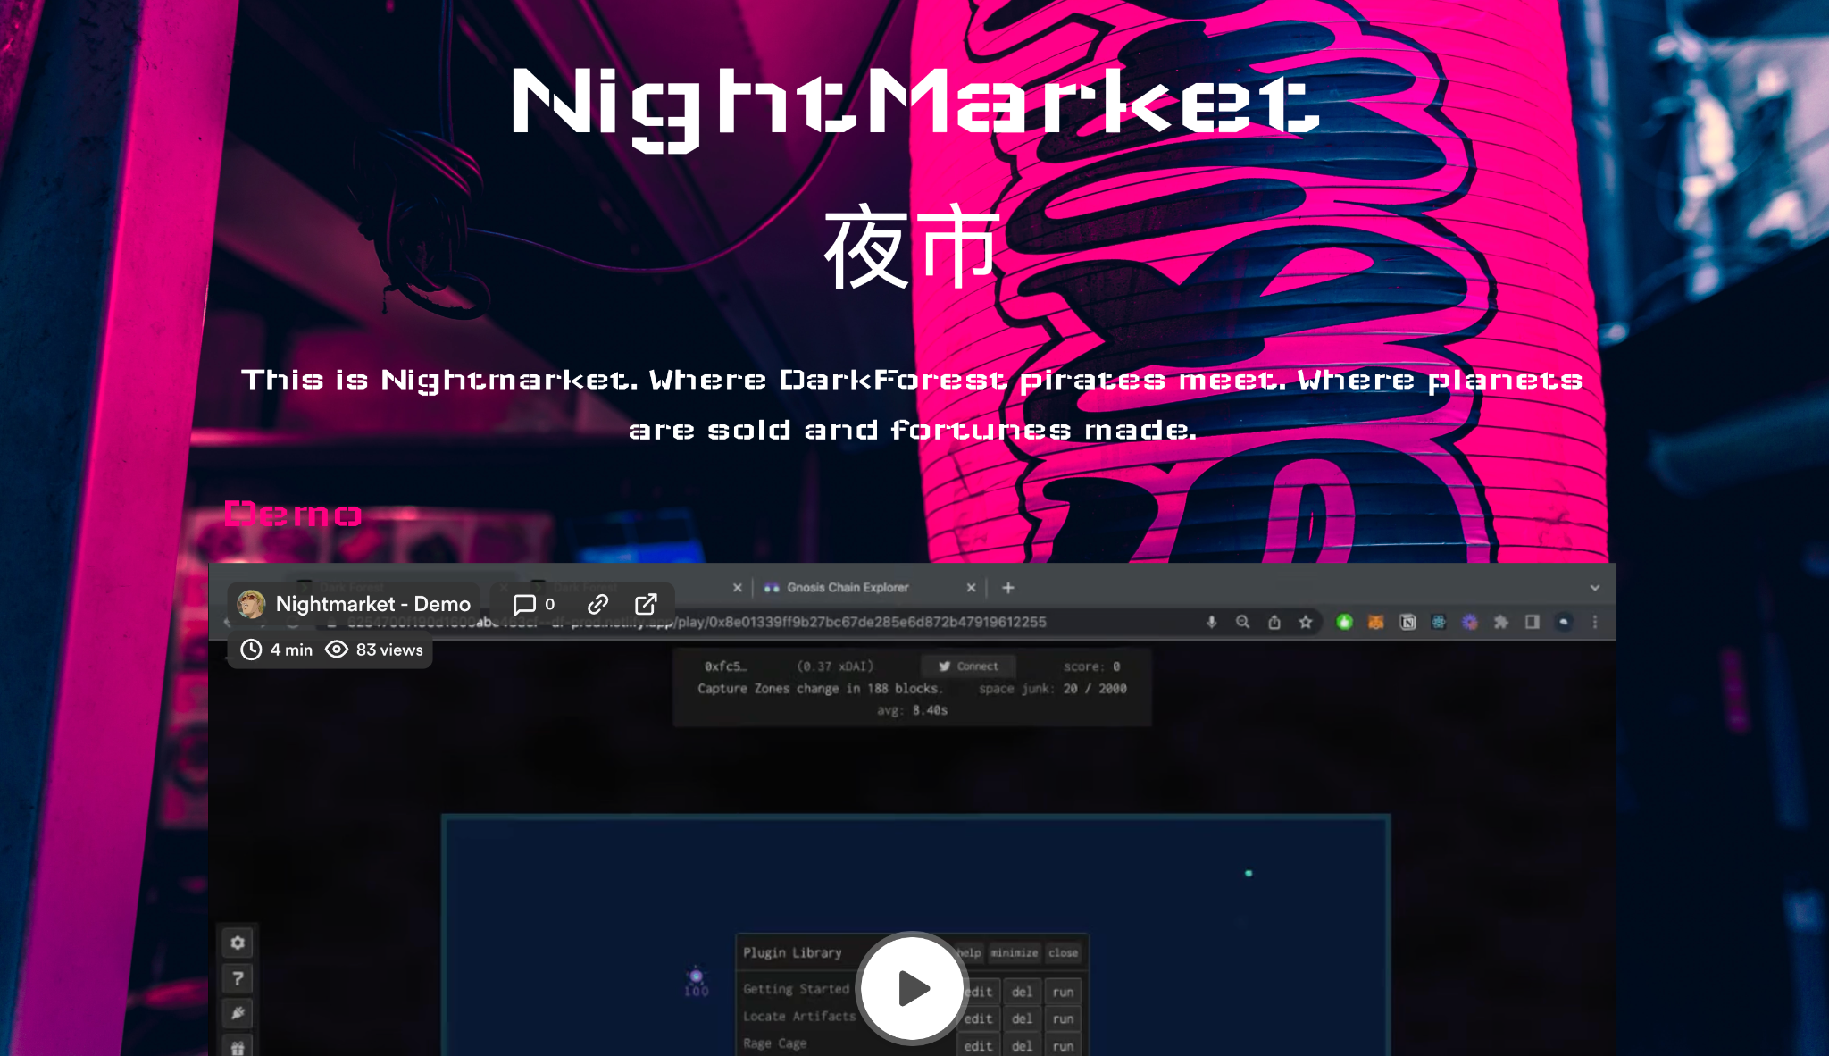
Nightmarket

Slide 39
Nightmarket
https://blog.zkga.me/nightmarket - 0xSage, xyz_pierre (2022)
https://nightmart.xyz/

Slide 40
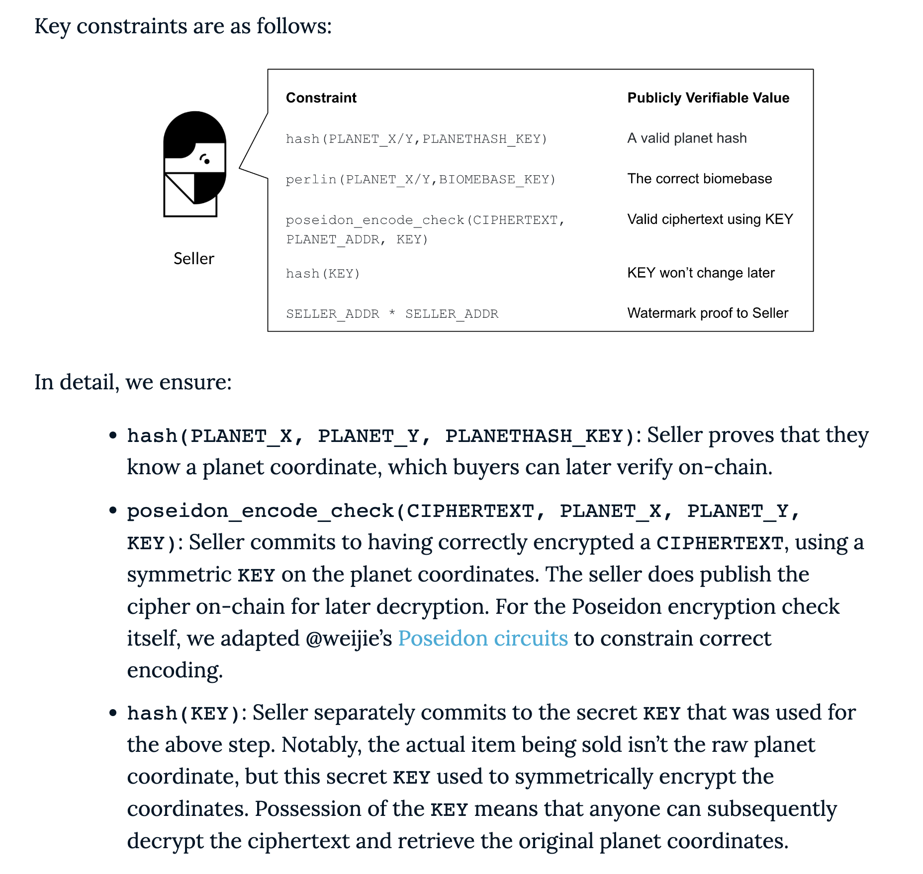
Nightmarket

Slide 41
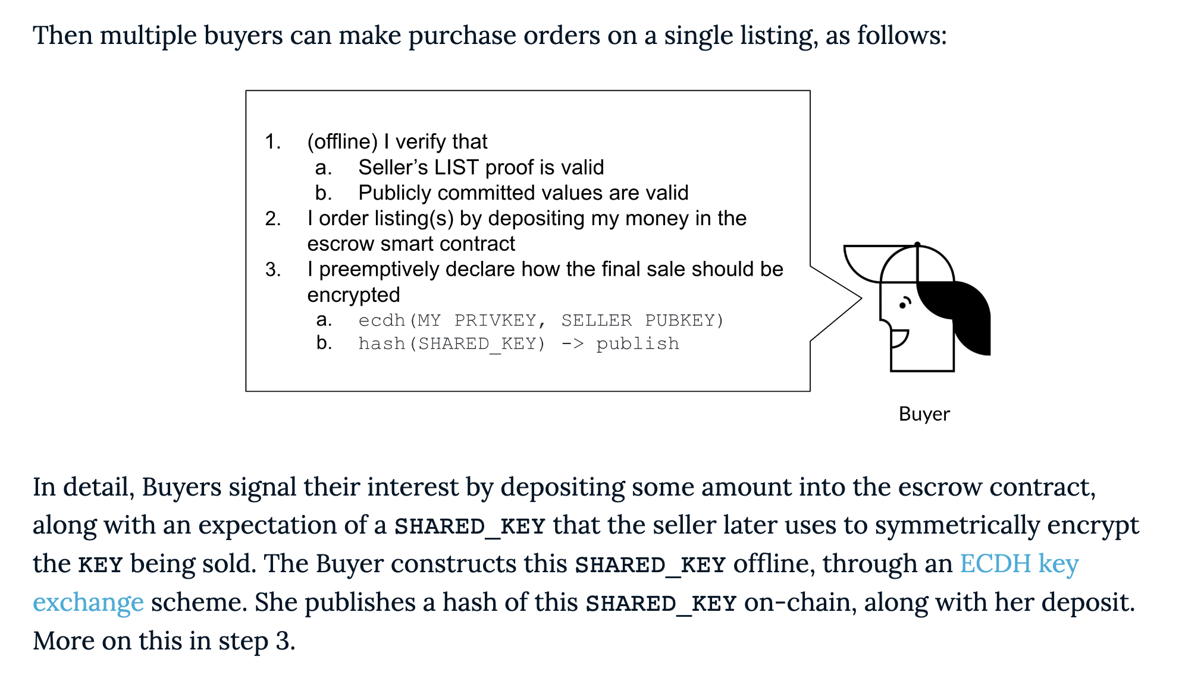
Nightmarket

Slide 42
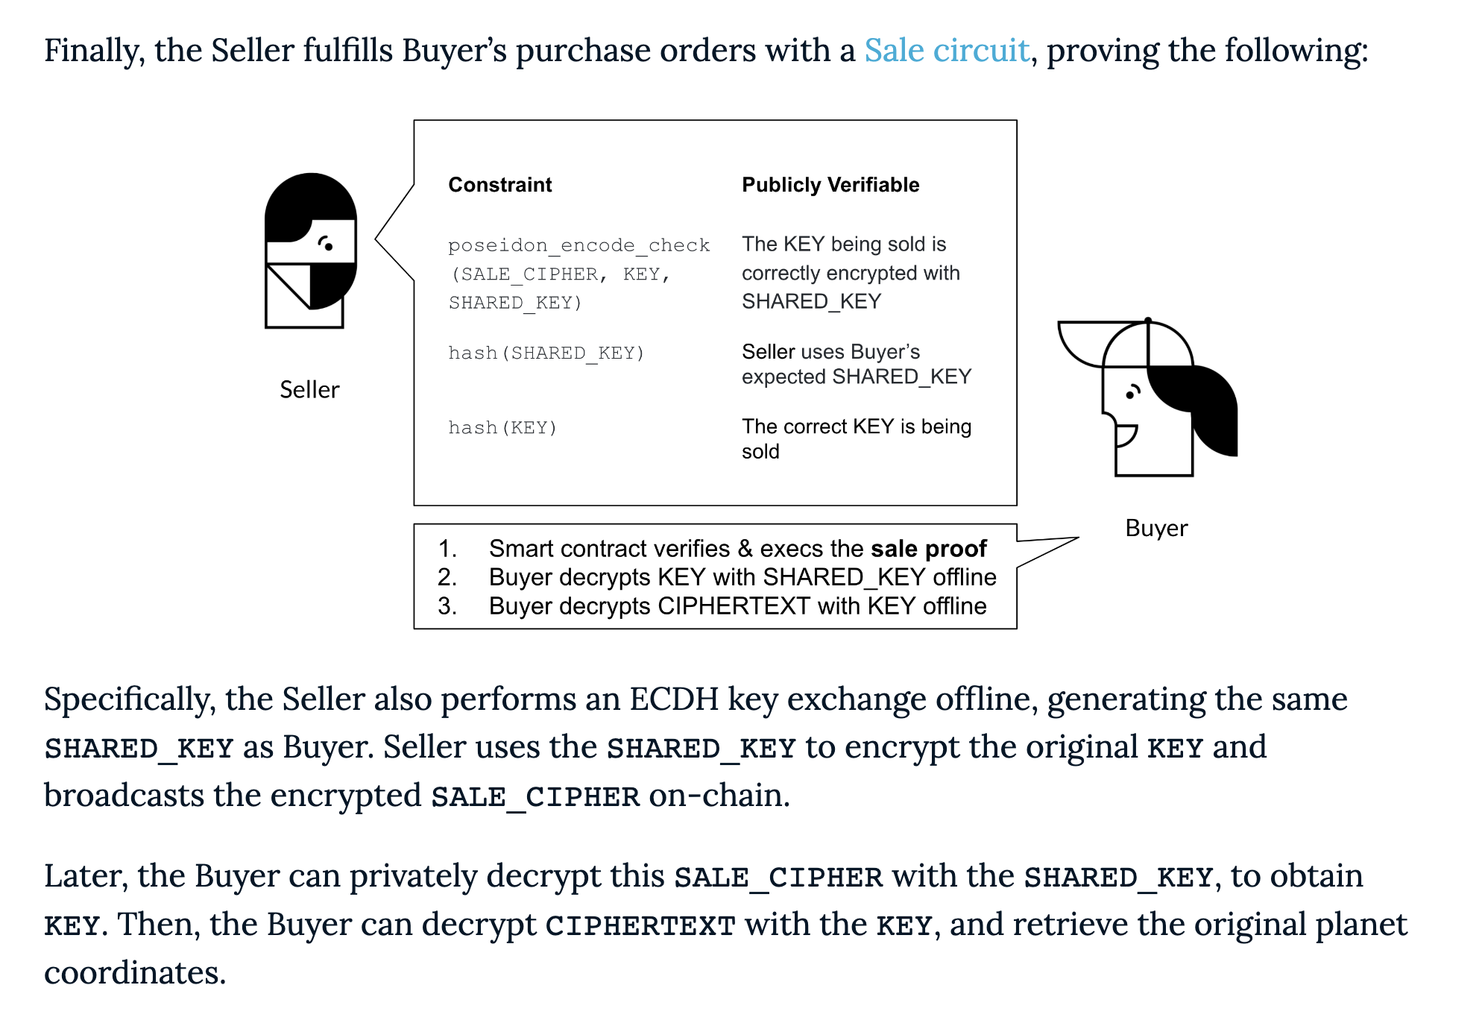
Nightmarket

Slide 43
What else can we sell?
A Bitcoin, Ethereum, SSH, DKIM private key
A smart contract exploit (or program exploit more generally)
A picture of a bird
…

Slide 44
ZKML
A neural network is a function.
Put it in a zkSNARK!

Slide 45
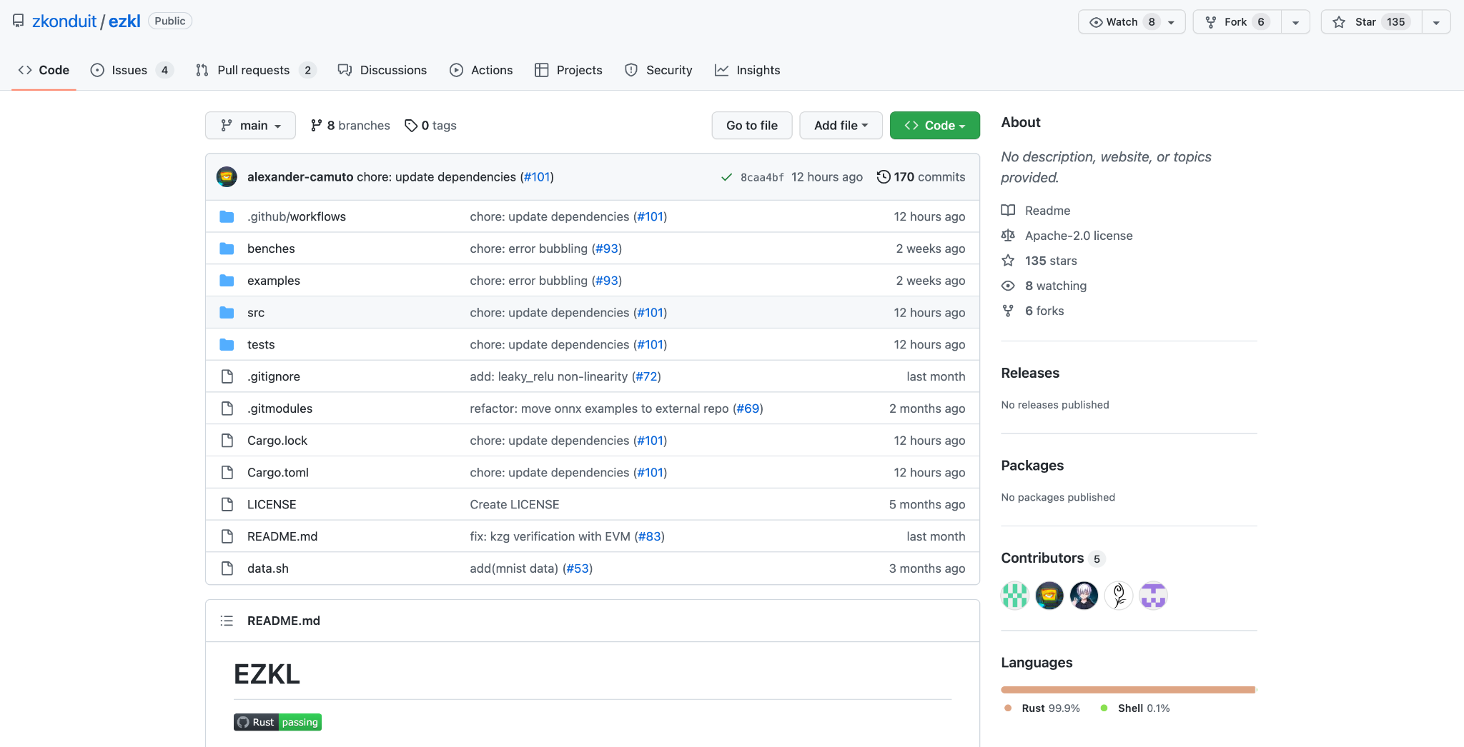
ZKML

Slide 46
ZKML
https://github.com/zkonduit/ezkl - Jason Morton (2022)
https://arxiv.org/pdf/2210.08674.pdf - Daniel Kang (2022)

Slide 47

Example Application 1: Verifiable Computation
In the future, suppose an LLM is used to judge a case (or offer expert recommendations, etc).
Who runs the LLM? Are they running it correctly? What if the LLM’s model parameters are proprietary?

Slide 48
Example Application 1: Verifiable Computation
Before any caseload: OpenAI commits to the model commit(model) = C
Then, on any run, proves…

Slide 49
Example Application 1: Verifiable Computation
Public inputs:
Input x
Claimed output y
Model commitment c
Private inputs:
Model M
Proves:
M(x) = y
commit(M) = c

Slide 50
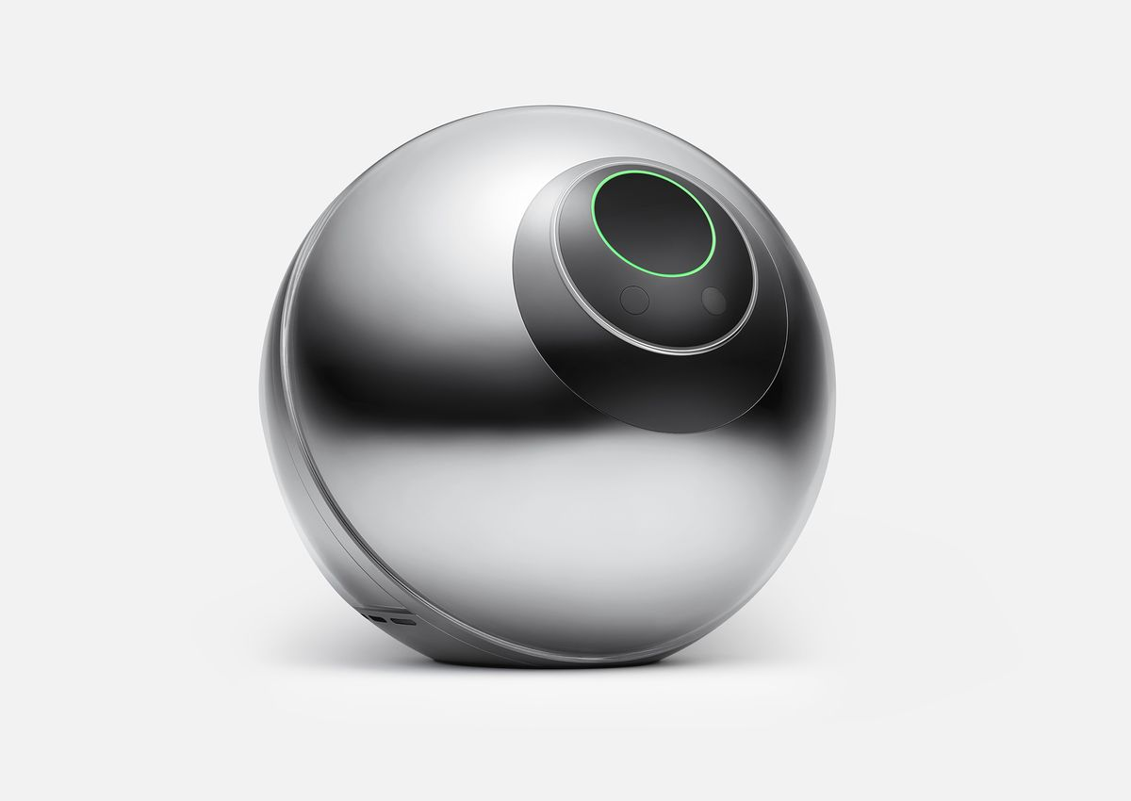

Example Application 2: ZK Biometrics
Problem: is biometric auth only possible in a world where large actors store (or have access to) our biometric data?

Slide 51
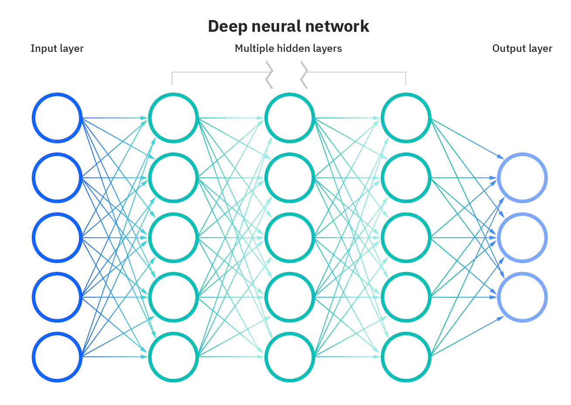
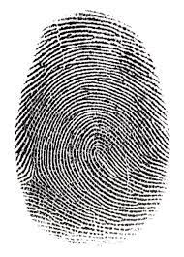

Example Application 2: ZK Biometrics
If a database of biometric hashes is known, then we can prove authorization without revealing our biometric data OR our specific ID
0x17c3ff3a
0x17c3ff3a ∈

Slide 52
Example Application 2: ZK Biometrics
Q: How would worldcoin give 1 worldcoin to every human on the planet, without being able to trace who corresponds to what address?
0x17c3ff3a
0x17c3ff3a ∈

Slide 53
Example Application 3: Decentralized Kaggle, Buying and Selling Models, Buying and Selling Data
?????

Slide 54
ZK Recursion
zkSNARKs allow you to generate succinct proofs of execution of any program.
zkSNARK verification is a program!

Slide 55
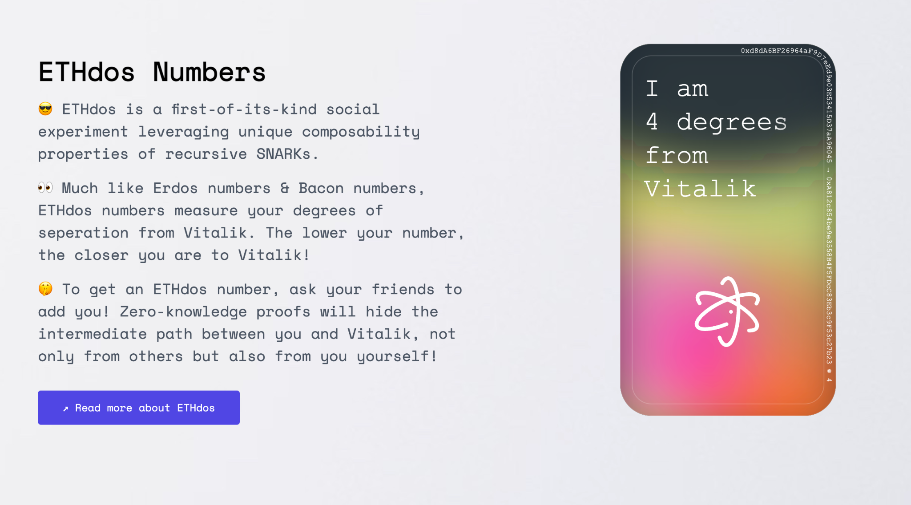
Application 1: ETHdos

Slide 56
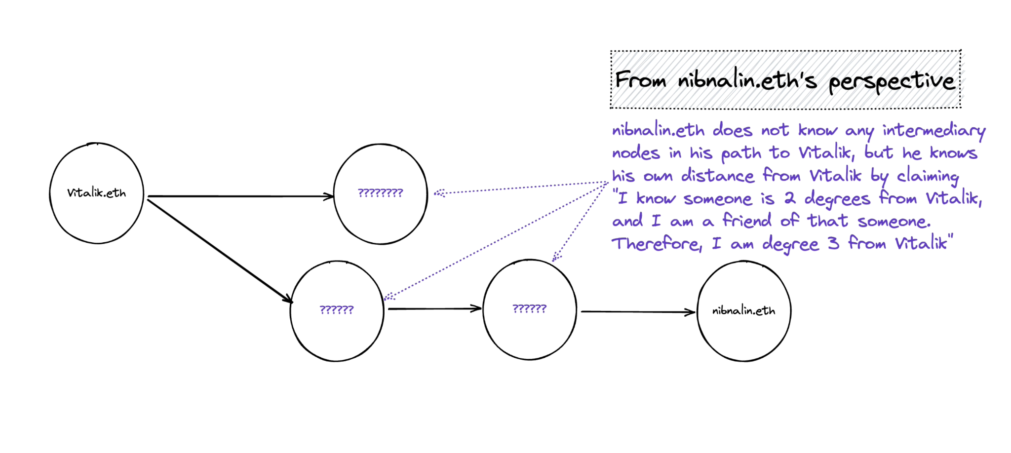
Application 1: ETHdos

Slide 57
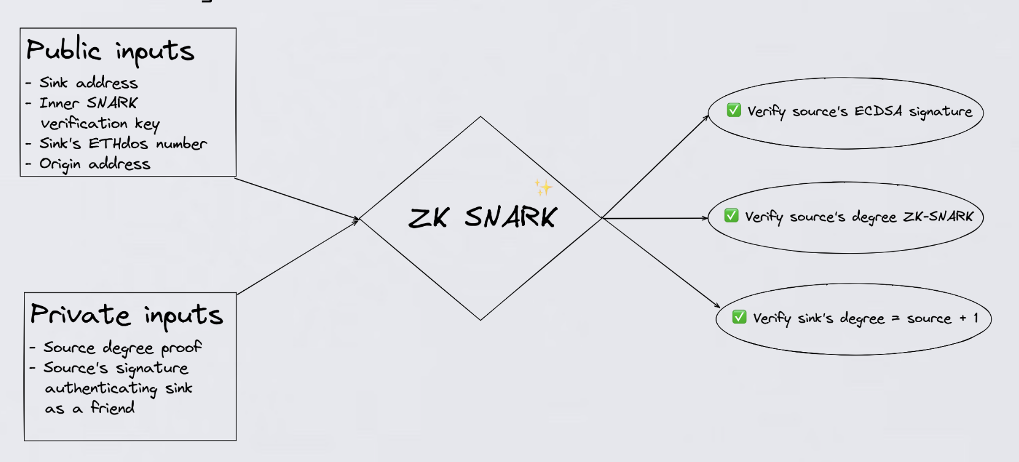
Application 1: ETHdos

Slide 58
ETHdos
https://ethdos.xyz/blog
Nalin, Adhyyan, Vivek, Sampriti

Slide 59
Friday - Final Demos!
5-7m each
Students and staff
Feel free to invite friends!

